Slide 1
Virulence Factors of Mammiliicoccus
Ashley Rosborough

Slide 2
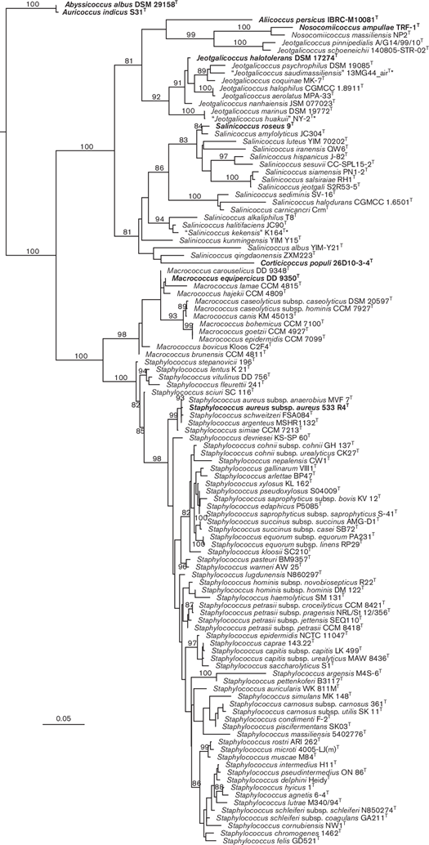
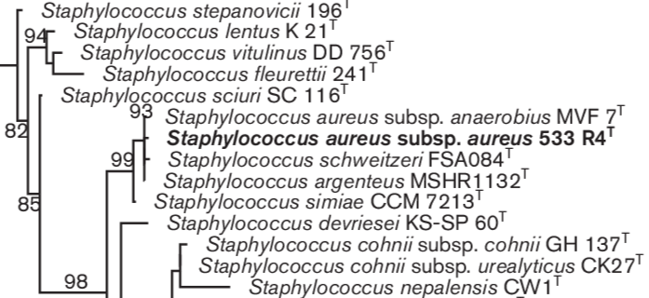
Background
Mammiliicoccus
Sister genus of Staphylococcus gena
Moved following 16s RNA
gene similarity analysis
Gram positive cocci
Non-motile
Non-spore forming

Slide 3
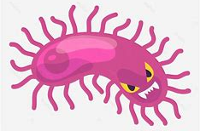
Mammiliicoccus and Disease
Non-aureus staphylococci and mammaliicocci (NASM)
Lack of coagulase virulence factor
Opportunistic pathogens
Mastitis in dairy animals
M. sciuri - ExhC Exfoliation and necrosis
Severe Exudative Epidermitis pig outbreak in China
Endocarditis, peritonitis, septic shock, UTI, PID, wound infections

Slide 4
Goal
High similarity to Staphylococcus aureus
Perform assembly of Mammiliicoccus genome
Identify and compare virulence factors
Highlight concerns with mushroom compost mediums

Slide 5
Sample Isolation
Anand Karki, Ph.D.
2015-2017 - Mushroom isolates cultured and identified
2020 - Illumina Miseq short reads
2022-2023 - Oxford Nanopore long reads
2024 - Got my hands on them

Slide 6
Trimming - Trimmomatic
Illumina short reads
Trimmed via Trimmomatic
Available adapters moved into master list
Removed:
ILLUMINACLIP - Adaptors
LEADING:3 - Low leading quality or N bases
TRAILING:3 - low trailing quality or N bases
SLIDINGWINDOW:4:15 - 4 b wide cut if average quality per base below 15
MINLEN:36 - Reads below 36 b in length

Slide 7
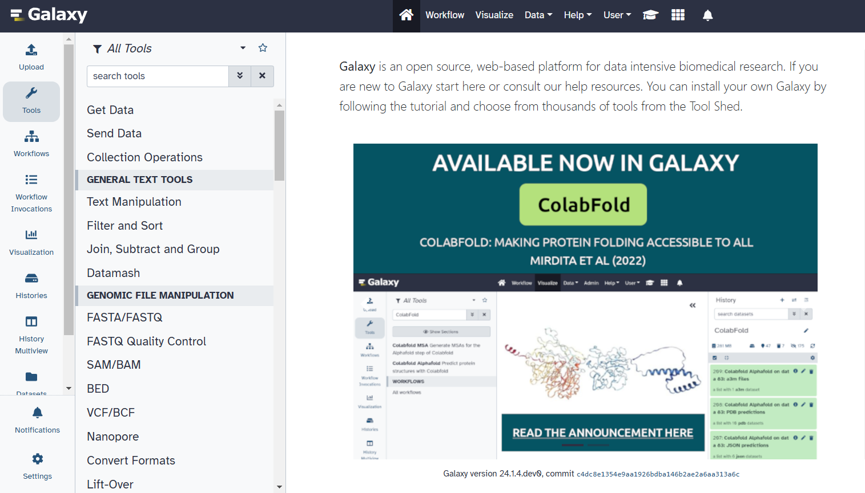
Trimming - Porechop
Oxford long reads
Trimmed via Galaxy’s Porechop
First and last bases aligned to adapter set
If over 90% adapter match, read trimmed
If match in middle of read, read is split
Concatenated

Slide 8
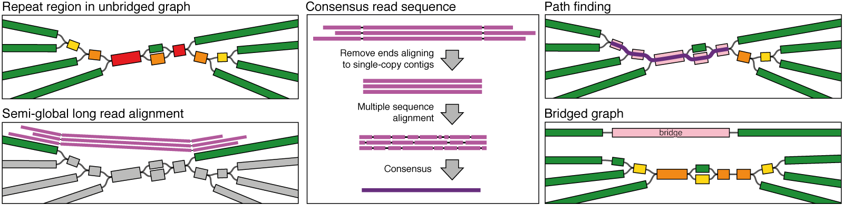
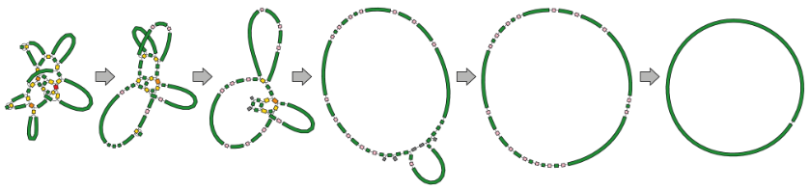
Assembly - Unicycler
Unicycler hybrid assembly
Repeats longer than the read - form singular contig
Uses SPAdes to produce de Bruijn graph
Different k-mer lengths - increased connections and repeat resolutions

Slide 9
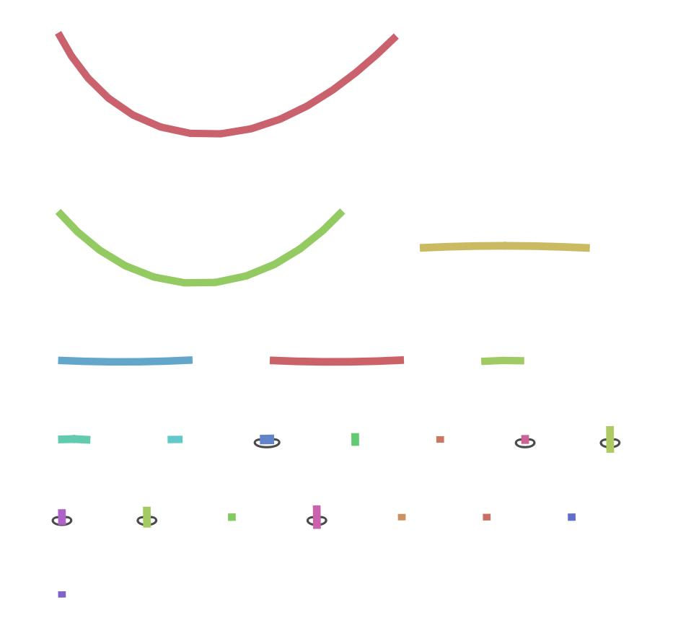

Bandage
Visualizes .gfa files

Slide 10
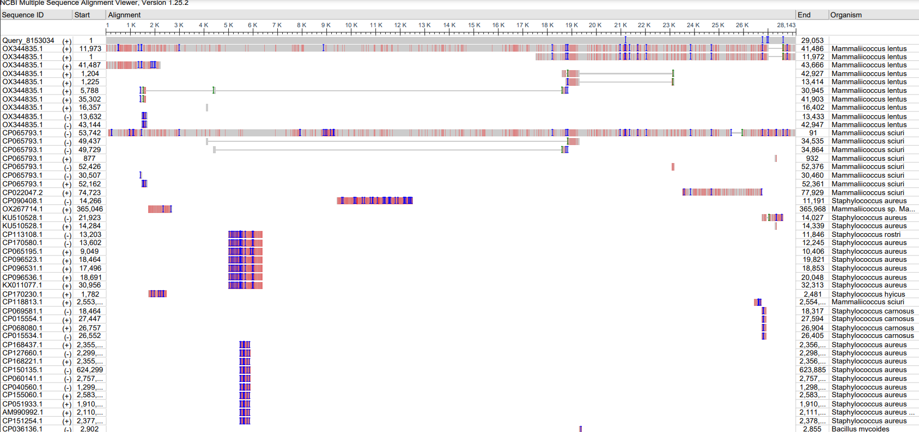
BLAST
bc01, bc02, bc11, and bc12 failures
bc03 and bc05 Mammaliicoccus vitulinus
bc04 and bc06 Staphylococcus xylosus
bc07 Staphylococcus pasterui
bc08 and bc09 Staphylococcus warneri
bc10 Staphylococcus haemolyticus

Slide 11
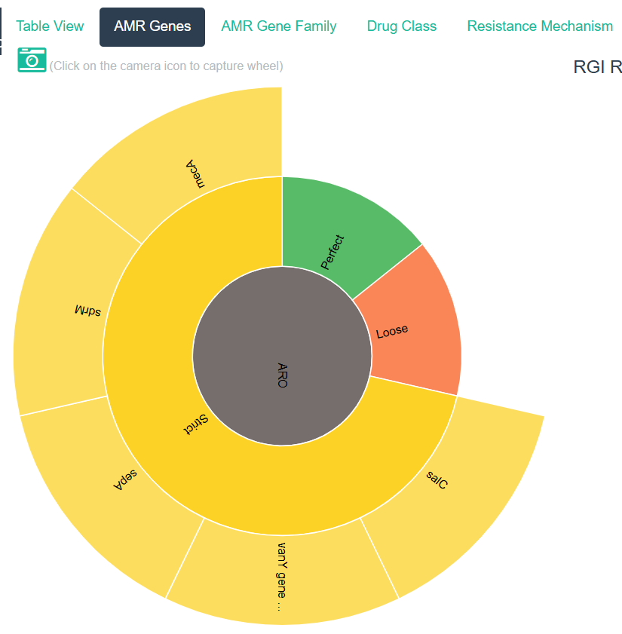
CARD RGI Resistance Gene Identifier
Separate contigs with circular=true
Generates .json and .txt files

Slide 12
CARD cont.
Mammaliicoccus vitulinus
bc03 and bc05 core genome
Glycopeptide
Antibiotic target alteration
Lincosamide, streptogramin, streptogramin A, pleuromutilin
Antibiotic target protection
Fluoroquinolone, disinfecting agents and antiseptics
Major facilitator superfamily (MFS) antibiotic efflux pump
Disinfecting agents and antiseptics
Small multidrug resistant (SMR) antibiotic efflux pump
Penam
Antibiotic target replacement
Methicillin resistant
bco3 plasmid
Disinfecting agents and antiseptics
SMR antibiotic efflux pump

Slide 13
Card cont.
Staphylococcus xylosus
bc04 core genome
Glycopeptide x2
Fluoroquinolone, disinfecting agents and antiseptics x2
MFS efflux
Disinfecting agents and antiseptics
SMR efflux
Phosphonic acid antibiotic
Antibiotic target alteration
bc04 plasmid
Disinfecting agents and antiseptics
SMR efflux
bc06 core genome
Glycopeptide x3
Lincosamide, streptogramin, streptogramin A, pleuromutilin
Antibiotic target protection
fluoroquinolone, disinfecting agents and antiseptics x3
MFS
Disinfecting agents and antiseptics
SMR efflux
bc06 plasmid
none

Slide 14
Card cont.
Staphylococcus pasterui
bc07 core genome
Glycopeptide
Antibiotic target alteration
Fluoroquinolone x2, aminoglycoside, penam, tetracycline, disinfecting agents and antiseptics x2
MFS
Phosphonic acid
Antibiotic inactivation
Fosfomycin thiol transferace
Aminocoumarin
Antibiotic target alteration
bc06 plasmid
Penam
Antibiotic inactivation
beta-lactamase

Slide 15
Card cont.
Staphylococcus warneri
bc08 core genome and 9
Glycopeptide x3
Antibiotic target alteration
Fluoroquinolone, disinfecting agents and antiseptics
MFS
Disinfecting agents and antiseptics
SMR
Aminocoumarin
Antibiotic target alteration
bc08 and bc09 plasmid
Macrolide, streptogramin, streptogramin B antibiotic
Antibiotic target protection
Penam
Antibiotic inactivation
Beta-lactamase
Fluoroquinolone, aminoglycoside, penam, tetracycline, disinfecting agents and antiseptics
MFS
bc09 core genome and 9
Glycopeptide x2
Antibiotic target alteration
Fluoroquinolone, disinfecting agents and antiseptics
MFS
Disinfecting agents and antiseptics
SMR
Aminocoumarin
Antibiotic target alteration

Slide 16
Card cont.
Staphylococcus haemolyticus
bc10 core genome
Glycopeptide x2
Antibiotic target alteration
Fluoroquinolone, disinfecting agents and antiseptics x3
MFS
Disinfecting agents and antiseptics
SMR
bc10 plasmid
Macrolide, streptogramin, streptogramin B
Antibiotic target protection
Macrolide antibiotic
Macrolide phosphotransferase

Slide 17
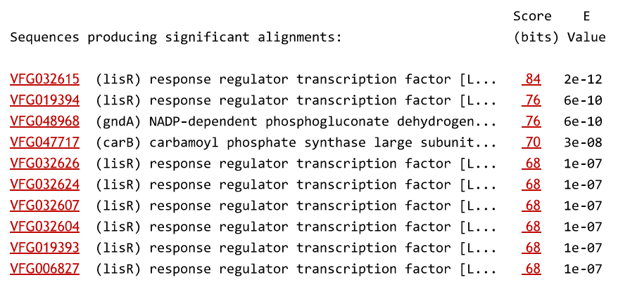
Virulence Factor of Pathogenic Bacteria (VFPD)
DNA sequences from full dataset

Slide 18
Future Directions
Finish analyzing resistances
Find way to identify and locate virulence factors
Merge remaining contigs - CLC
Analysis comparing virulence genes between my samples and S. aureus

Slide 19
Resources
Cheung, Gordon Y. C., et al. “Pathogenicity and Virulence of Staphylococcus Aureus.”
PubMedCentral, U.S. National Library of Medicine, 31 Jan. 2021, www.ncbi.nlm.nih.gov/pmc/articles/PMC7872022/.
França, Angela, et al. “Virulence Factors in Coagulase-Negative Staphylococci.”
PubMedCentral, U.S. National Library of Medicine, 4 Feb. 2021, www.ncbi.nlm.nih.gov/pmc/articles/PMC7913919/.
Gismene, Carolina, et al. “Necrotic Activity of EXHC from Mammaliicoccus Sciuri Is Mediated by Specific Amino Acid Residues.”
International Journal of Biological Macromolecules, Elsevier, 29 Oct. 2023, www.sciencedirect.com/science/article/abs/pii/S0141813023046391.
Ingimage. Evil Bacteria. pngTREE, https://pt.pngtree.com/freepng/angry-bacteria-evil-germ-microbe_8139504.html.
Madhaiyan, Munusamy, et al. “Phylogenomic Analyses of the Staphylococcaceae Family
Suggest the Reclassification of Five Species within the Genus Staphylococcus as Heterotypic Synonyms, the Promotion of Five Subspecies to Novel Species, the Taxonomic Reassignment of Five Staphylococcus Species to Mammaliicoccus Gen. Nov., and the Formal Assignment of Nosocomiicoccus to the Family Staphylococcaceae.” Microbiology Research, Microbiology Society, 14 Oct. 2020, www.microbiologyresearch.org/content/journal/ijsem/10.1099/ijsem.0.004498#tab2.
National Center for Biotechnology Information (NCBI)[Internet]. Bethesda (MD): National Library of Medicine (US), National Center for
Biotechnology Information; [1988] – [cited 2017 Apr 06]. Available from: https://www.ncbi.nlm.nih.gov/
Ruiz-Romero, Rocio Angélica, and Einar Vargas-Bello-Pérez. “Non-Aureus Staphylococci and Mammaliicocci as a Cause of Mastitis in
Domestic Ruminants: Current Knowledge, Advances, Biomedical Applications, and Future Perspectives - A Systematic Review.” Springer, U.S. National Library of Medicine, Sept. 2023, pmc.ncbi.nlm.nih.gov/articles/PMC10038778/.
“Porechop.” Galaxy, usegalaxy.org/root?tool_id=toolshed.g2.bx.psu.edu%2Frepos%2Fiuc%2Fporechop%2Fporechop%2F0.2.4
%2Bgalaxy0.
Usadellab, BjoernUsadel. “Trimmomatic.” GitHub, github.com/usadellab/Trimmomatic.
Wick, Ryan. “Unicycler: Hybrid Assembly Pipeline for Bacterial Genomes.” GitHub, github.com/rrwick/Unicycler.

Slide 20

Thank you!
Any questions?

